Slide 1
INTRODUCTION
DATA ENTERY DEVICES
Presentation By:
Momin Khan
Abdul Basit
Muhammad Faeiz

Slide 2
Direct Data Entry Devices
Direct data entry devices capture data
directly from the source, reducing manual effort.

Slide 3
Overview of Direct Data Entry Devices
Advantages:
1. Fast data capture
2. Reduces human error
3. Can handle large volumes of data
Disadvantages:
1. High initial setup costs
2. Maintenance and security risks
3. Specialized hardware required

Slide 4
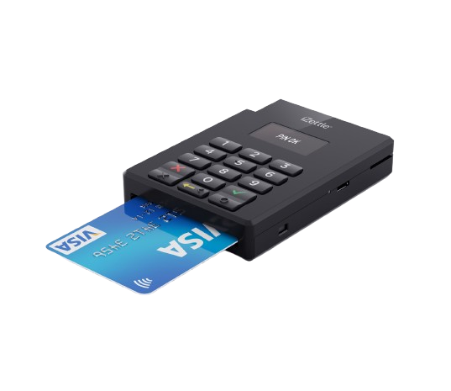
Chip Readers
Internal Working:
Chip readers work by reading data embedded in chips using electromagnetic signals.
Advantages:
Fast, Secure, widely used in payment systems.
Disadvantages:
Requires specialized hardware, vulnerable to hacking.

Slide 5
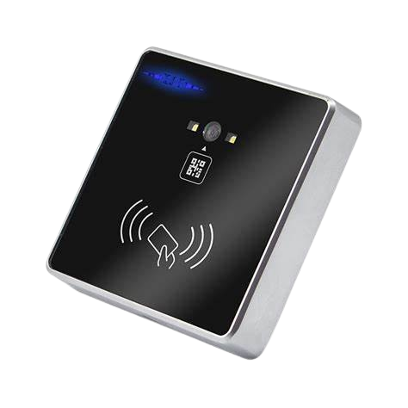
RFID Readers
Internal Working:
RFID readers use radio waves to read data from RFID tags.
Advantages:
Fast, can read multiple tags simultaneously, doesn't require line of sight.
Disadvantages:
Expensive, can be intercepted.

Slide 6
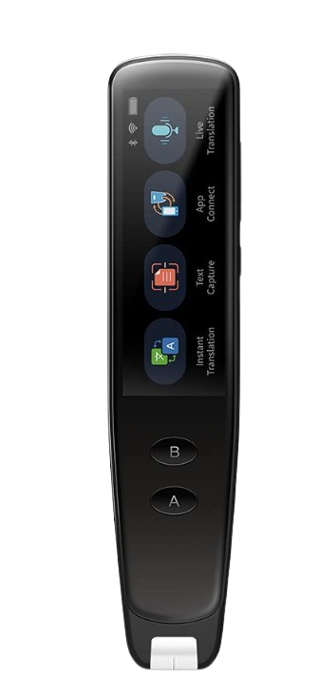
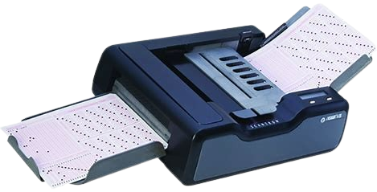
OCR & OMR
Internal Working:
OCR (Optical Character Recognition) reads printed characters.
OMR (Optical Mark Recognition) reads marks on documents.
Advantages:
Reduces manual data entry, can process large volumes quickly.
Disadvantages:
OCR can struggle with handwriting; OMR needs structured forms.

Slide 7


Barcode and QR Code Readers
Internal Working:
Barcode readers scan the black and white patterns on barcodes, while QR code readers scan 2D patterns.
Advantages:
Inexpensive, widely used, and reliable.
Disadvantages:
Limited data capacity (for barcodes), need a clear view of the code.

Slide 8
Conclusion
Direct data entry devices play a vital role in automating data capture, reducing errors, and increasing efficiency.
While each device has its advantages and disadvantages, choosing the right one depends on the specific needs of the organization.

Slide 9
Thank You!
Any Questions?

